Slide 1
JAVA Project
Project : Alumuni DataBase
By : K . Tripura (16XJ1A0509)
M. Jahnavi (16XJ1A0521)

Slide 2
Problem statements
Topic: creation of a GUI interface for Alumini Database
Problems Faced: the query posted is dissapeared when the frame is minimised and then maximized .
Do’s :
Login ,recovery for password, logout ,posting related queries in the Disscussion Forum
Dont’s:
Sign up

Slide 3
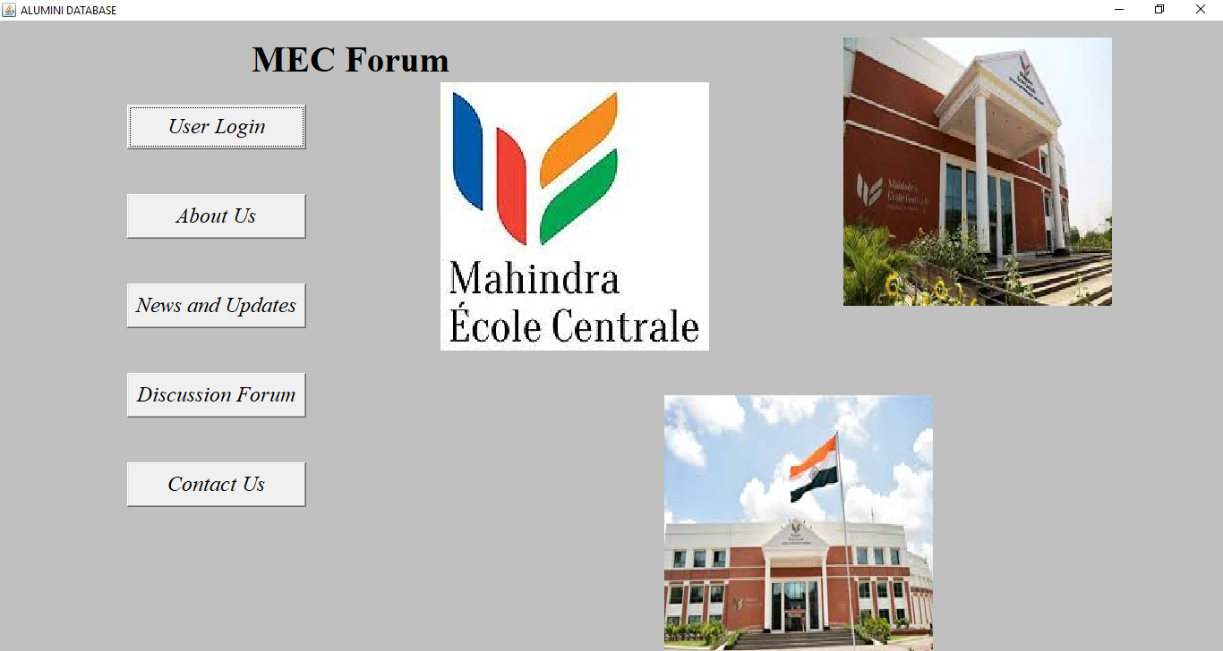
MainFrame

Slide 4
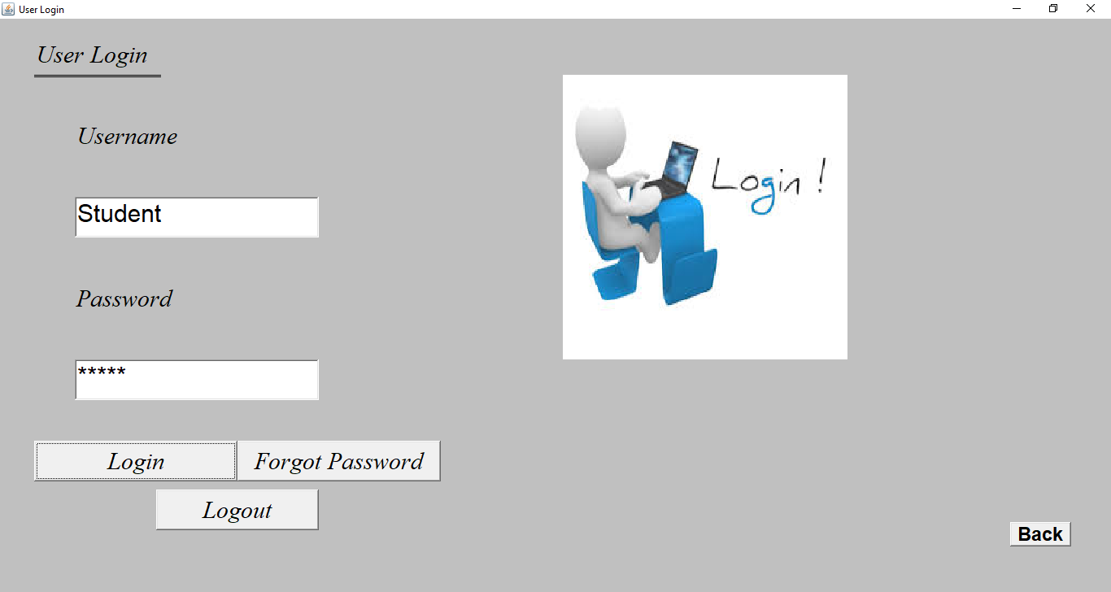
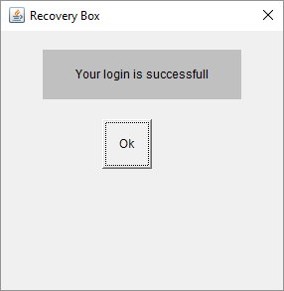
UserLogin Frame

Slide 5
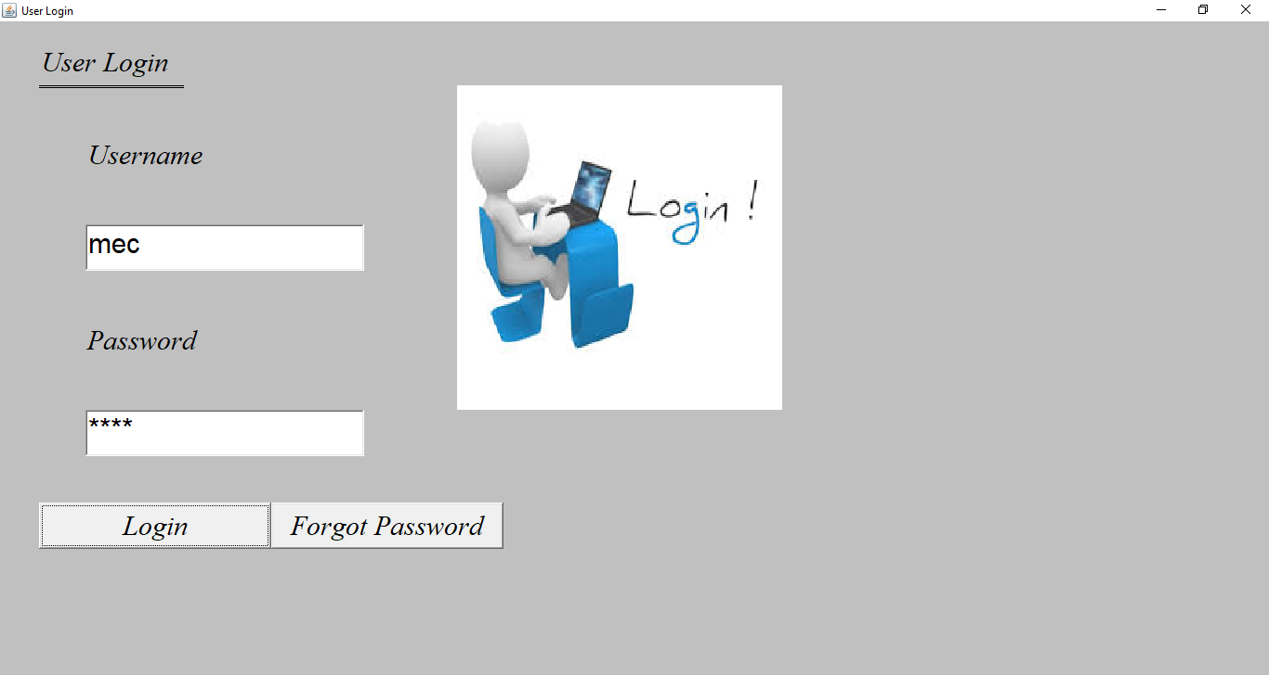
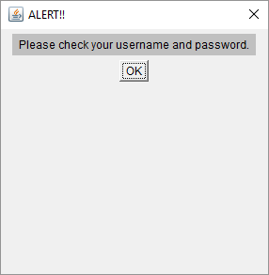

Slide 6
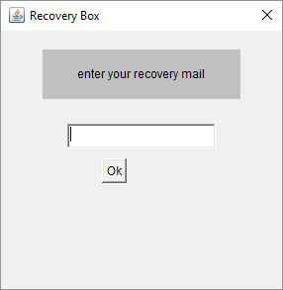

Slide 7

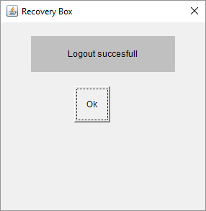

Slide 8
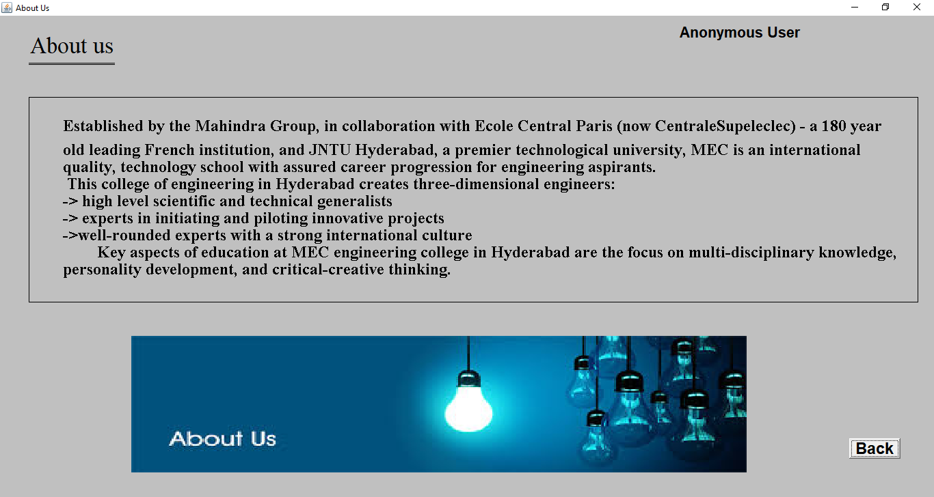

Slide 9
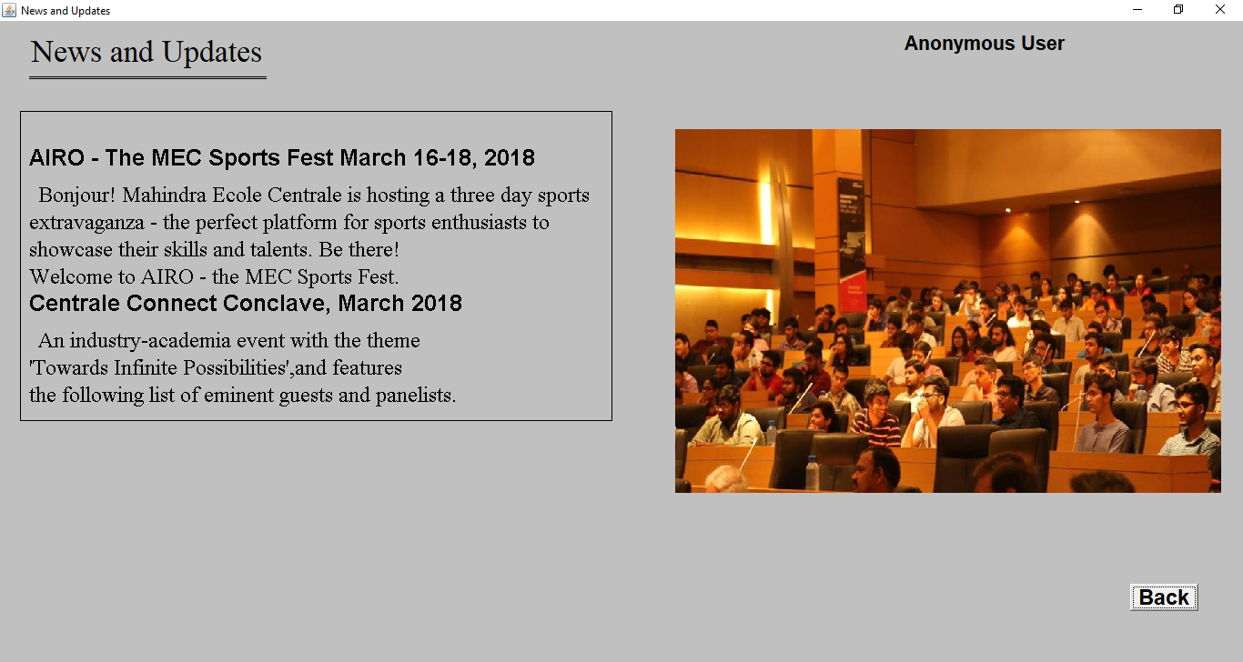

Slide 10
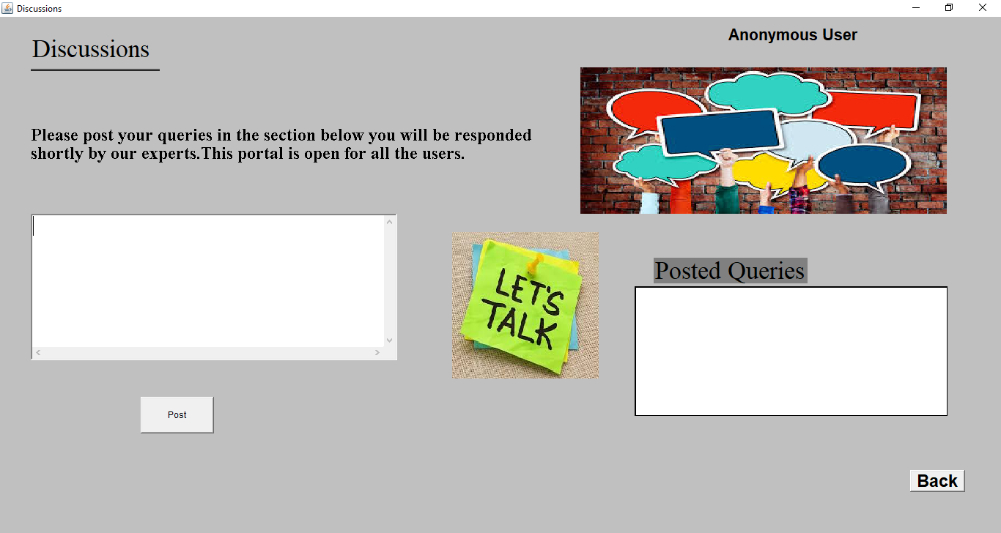
Initial Discussions Frame

Slide 11
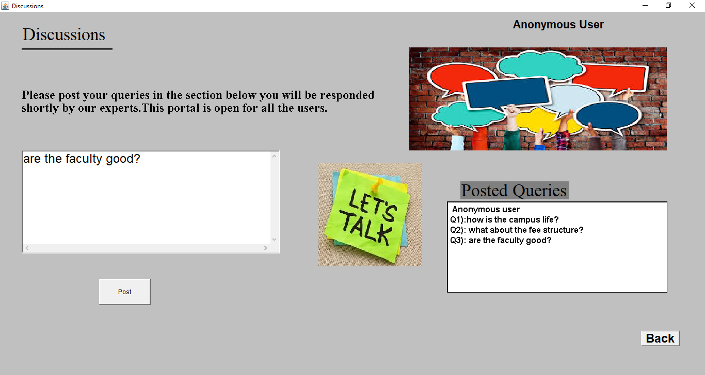
Case when an anonymous user posts queries

Slide 12

Case when a Student logs in to post queries

Slide 13
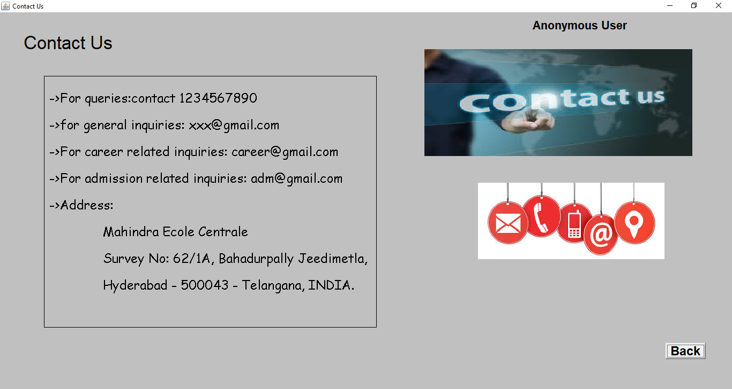

Slide 14
Data Flow Diagram
MainFrame
(MEC forum)
UserLogin
Login
Forgot Password
About Us
back
Logout
News and Updates
Discussions
Post your queries
Contact Us

